Slide 1
OOP & data struct 14. Graph
By Somsin Thongkrairat

Slide 2


Slide 3
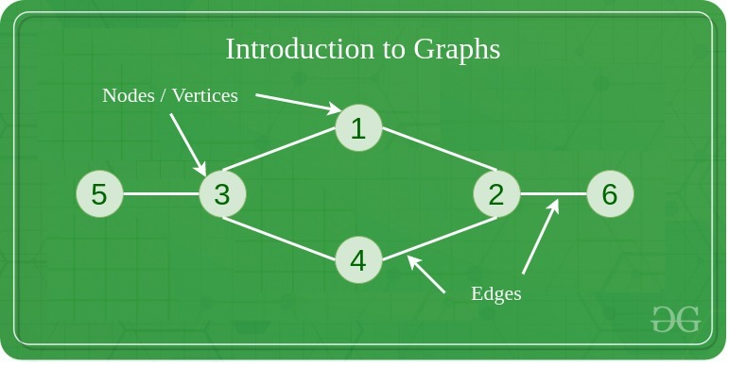
Graph
https://www.geeksforgeeks.org/graph-data-structure-and-algorithms/

Slide 4
Graph
- fundamental non-linear data structure consisting of node(vertex) and path(edge)
- node(vertex) is an item or element in structure
- path(edge) is the information that how each node connected
- เป็น structure พื้นฐานแบบ non-linear ที่ประกอบไปด้วย node(vertex) และ path(edge)
- node(vertex) คือ item หรือ element ใน structure
- path(edge) คือข้อมูลที่บอกว่าแต่ละ node เชื่อต่อกันอย่างไร

Slide 5
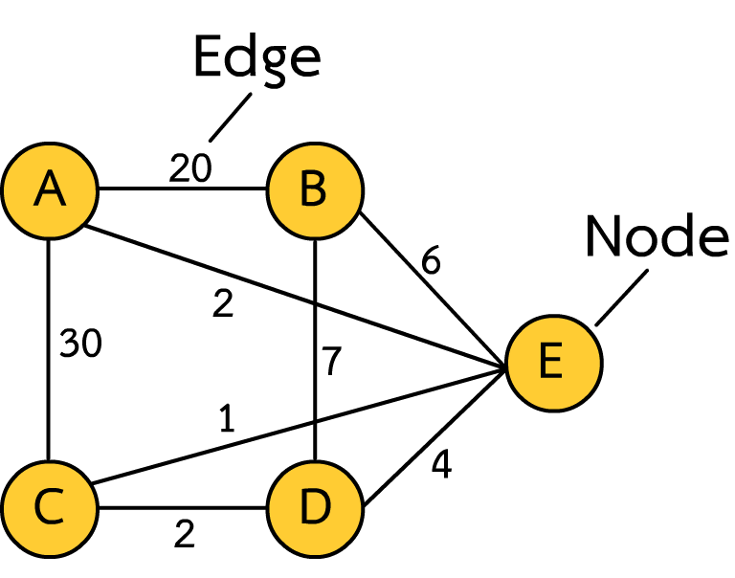
Component of graph
- Node contain data object
- Edge contain travel cost between node
- Node เก็บข้อมูลของแต่ละ object
- Edge เก็บ cost ของการเดินทางระหว่าง node

Slide 6
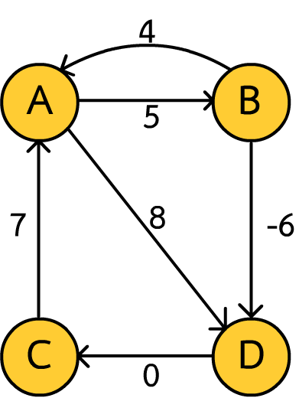
type of graph
- There are several type of graph classified by rule
- graph มีหลายชนิดจัดประเภทตามกฎ
Direct / undirect
Non-negative edge / floating point edge
Cyclic graph / Acyclic graph

Slide 7
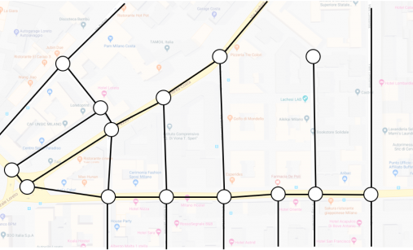

Depend on purpose
https://dreamcivil.com/systems-of-plumbing/
https://junkee.com/google-maps-has-been-tracking-your-every-move-and-theres-a-website-to-prove-it/39639

Slide 8

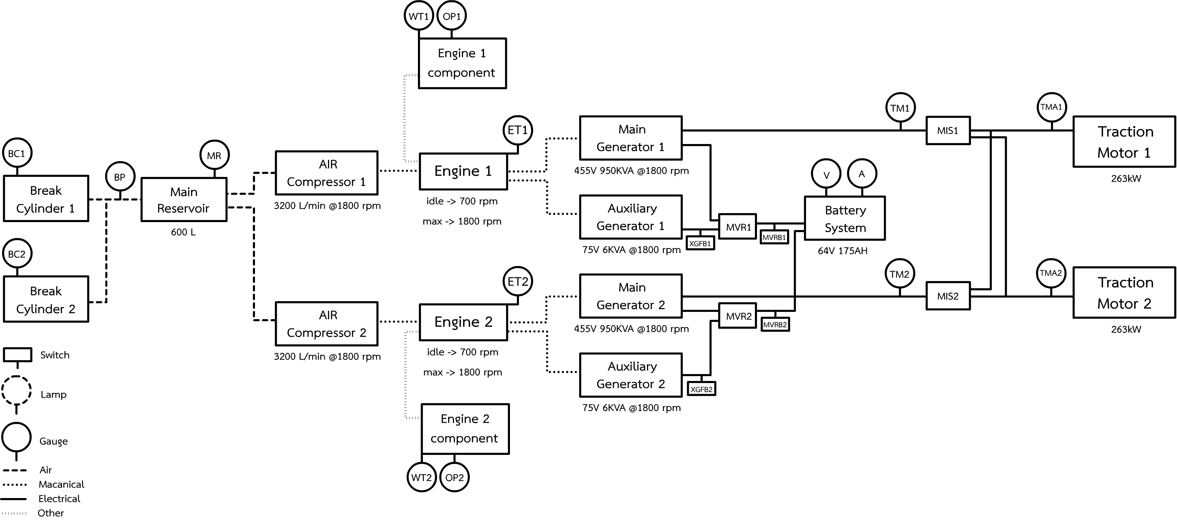
Depend on purpose

Slide 9
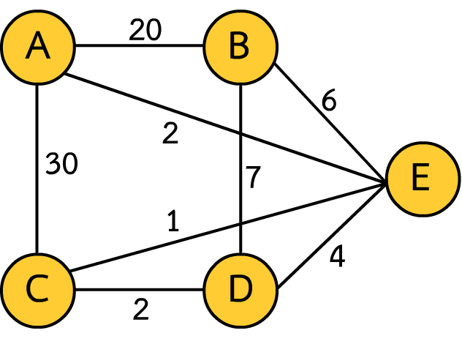
Our scope
- Non-negative edge undirected cyclicable graph
Edge can’t be negative cost
All edge can use any direction to travel
แต่ละ edge จะไม่มี cost ที่ติดลบ
ทุก edge ใช้เส้นทางใดก็ได้

Slide 10
Before we start
- Tree is subset of graphs with restricted rule, So tree always a graph but not all graph will be tree
- Tree เป็น subset ของ graph ที่มีกฎของตัวเอง ดังนั้น tree ทุกตัวจะเป็น graph แต่ไม่ใช่ว่า graph ทุกตัวจะเป็น tree

Slide 11
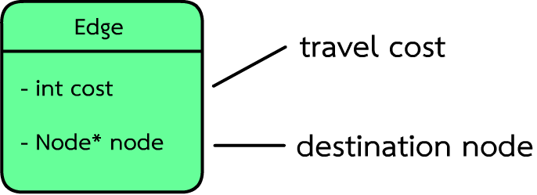
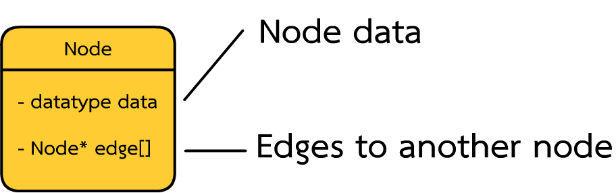
Data structure object base graph (node & edge)

Slide 12
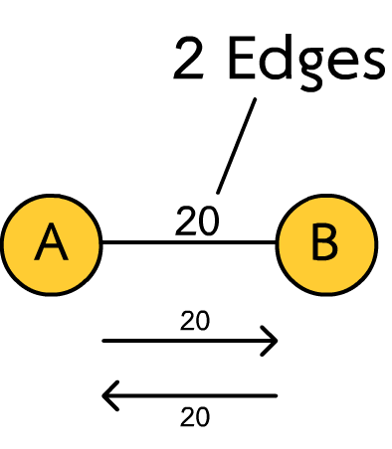
Edge (undirected graph)
class Edge{
public :
int cost;
Node* node;
Edge(int _cost,Node* dest){
cost = _cost;
node = dest;
}
};

Slide 13
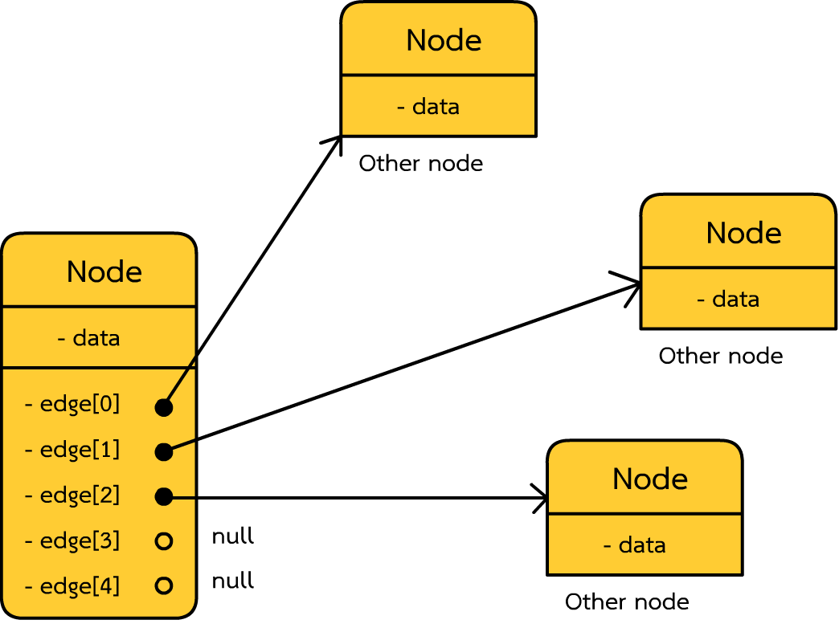
Code (fixed node number)
class Node{
public :
char data;
int edge_count;
Edge* edges[5]; Node(char item){
data = item;
edge_count = 0;
} void add_edge(int cost,Node* n){
edges[edge_count] = new Edge(cost,n);
edge_count++;
}
};

Slide 14
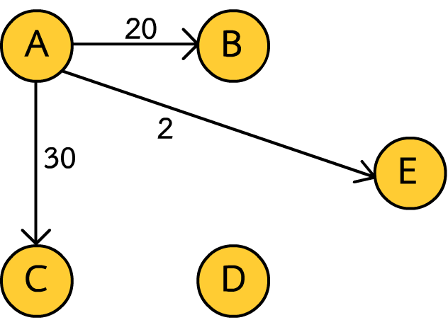
Build graph (each node)
Node a('A');
Node b('B');
Node c('C');
Node d('D');
Node e('E');
a.add_edge(20,&b);
a.add_edge(2 ,&e);
a.add_edge(30,&c);
Now only one way

Slide 15
Build graph
a.add_edge(20,&b);
a.add_edge(2 ,&e);
a.add_edge(30,&c);
b.add_edge(20,&a);
b.add_edge(7 ,&d);
b.add_edge(6 ,&e);
c.add_edge(30,&a);
c.add_edge(1 ,&e);
c.add_edge(2 ,&d);
d.add_edge(2 ,&c);
d.add_edge(7 ,&b);
d.add_edge(4 ,&e);
e.add_edge(6 ,&b);
e.add_edge(2 ,&a);
e.add_edge(1 ,&c);
e.add_edge(4 ,&d);

Slide 16
Print graph (node)
void print(){ // method in node
cout << data << "-> ";
for(int i=0;i<edge_count;i++){
cout << "(" << edges[i]->cost <<","<< (edges[i]->node)->data << ")";
}
cout << endl;
}
Result :
A-> (20,B)(2,E)(30,C)
B-> (20,A)(7,D)(6,E)
C-> (30,A)(1,E)(2,D)
D-> (2,C)(7,B)(4,E)
E-> (6,B)(2,A)(1,C)(4,D)
a.print();
b.print();
c.print();
d.print();
e.print();

Slide 17
Result :
A-> (20,B)(2,E)(30,C)
B-> (20,A)(7,D)(6,E)
C-> (30,A)(1,E)(2,D)
D-> (2,C)(7,B)(4,E)
E-> (6,B)(2,A)(1,C)(4,D)

Slide 18
Access
- Can start from any node / สามารถเริ่มใช้จาก node ใดก็ได้
Result :
A-> (20,B)(2,E)(30,C)
B-> (20,A)(7,D)(6,E)
C-> (30,A)(1,E)(2,D)
D-> (2,C)(7,B)(4,E)
E-> (6,B)(2,A)(1,C)(4,D)

Slide 19
example
A-> (20,B)(2,E)(30,C)
B-> (20,A)(7,D)(6,E)
C-> (30,A)(1,E)(2,D)
D-> (2,C)(7,B)(4,E)
E-> (6,B)(2,A)(1,C)(4,D)
How much total cost for this path from A to E
cout << a.edges[0]->cost + b.edges[1]->cost + d.edges[2]->cost << endl; // 31

Slide 20
example
A-> (20,B)(2,E)(30,C)
B-> (20,A)(7,D)(6,E)
C-> (30,A)(1,E)(2,D)
D-> (2,C)(7,B)(4,E)
E-> (6,B)(2,A)(1,C)(4,D)
How much total cost for this path from A to E
cout << a.edges[0]->cost + b.edges[2]->cost << endl; // 26

Slide 21
example
A-> (20,B)(2,E)(30,C)
B-> (20,A)(7,D)(6,E)
C-> (30,A)(1,E)(2,D)
D-> (2,C)(7,B)(4,E)
E-> (6,B)(2,A)(1,C)(4,D)
How much total cost for this path from A to E
cout << a.edges[1]->cost << endl; // 2

Slide 22
End of graph structure
Happy?

Slide 23
Quiz
Shortest path?

Slide 24
Why graph
- more flexible than tree
- more complex algorithm implementation***
- seem like realistic modelling (such as networking traffic)
- ยืดหยุ่นกว่า tree
- สามารถใช้ algorithm ที่ซับซ้อนได้มากกว่า***
- สามารถ modeling ให้เหมือนกันความเป็นจริงได้ เช่น networking การจราจร

Slide 25
Example program
- second order visited
List all possibility node that can visit with in 2 move
แสดง node ทั้งหมดที่เป็นไปได้ ที่สามารถเข้าถึงได้ด้วยการเดิน 2 ครั้ง

Slide 26

Remark ***
- following algorithm is just a partial algorithm can’t use in real life application
- algorithm ต่อไปนี้เป็นเพียงส่วนหนึ่งของ algorithm เท่านั้นไม่สามารถนำไปใช้จริงได้

Slide 27
second order visited
void second_order_visited(Node* n){
for(int i = 0;i<n->edge_count;i++){ // like print
Node* node1 = (n->edges[i])->node;
int cost1 = (n->edges[i])->cost;
for(int j=0;j<node1->edge_count;j++){
Node* node2 = (node1->edges[j])->node;
int cost2 = cost1 + (node1->edges[j])->cost;
cout << n->data << "->" << node1->data << "->" << node2->data << " = " << cost2 << endl;
}
}
}

Slide 28
second order visited
second_order_visited(&a);
A->B->A = 40
A->B->D = 27
A->B->E = 26
A->E->B = 8
A->E->A = 4
A->E->C = 3
A->E->D = 6
A->C->A = 60
A->C->E = 31
A->C->D = 32

Slide 29
third order visited
void third_order_visited(Node* n){
for(int i = 0;i<n->edge_count;i++){ // like print
Node* node1 = (n->edges[i])->node;
int cost1 = (n->edges[i])->cost;
for(int j=0;j<node1->edge_count;j++){
Node* node2 = (node1->edges[j])->node;
int cost2 = cost1 + (node1->edges[j])->cost;
for(int k=0;k< node2->edge_count;k++){
Node* node3 = (node2->edges[k])->node;
int cost3 = cost2 + (node2->edges[k])->cost;
cout << n->data << "->" << node1->data << "->" << node2->data << "->" << node3->data << " = " << cost3 << endl;
}
}
}
}

Slide 30
third order visited
A->C->E->D = 35
A->C->D->C = 34
A->C->D->B = 39
A->C->D->E = 36
A->B->A->B = 60
A->B->A->E = 42
A->B->A->C = 70
A->B->D->C = 29
A->B->D->B = 34
A->B->D->E = 31
A->B->E->B = 32
A->B->E->A = 28
A->B->E->C = 27
A->B->E->D = 30
A->E->B->A = 28
A->E->B->D = 15
A->E->B->E = 14
A->E->A->B = 24
A->E->A->E = 6
A->E->A->C = 34
A->E->C->A = 33
A->E->C->E = 4
A->E->C->D = 5
A->E->D->C = 8
A->E->D->B = 13
A->E->D->E = 10
A->C->A->B = 80
A->C->A->E = 62
A->C->A->C = 90
A->C->E->B = 37
A->C->E->A = 33
A->C->E->C = 32

Slide 31
Forth? Fifth? Sixth?
n order visited = graph traversal
- inorder
- postorder
- preorder

Slide 32
nearest neighbor graph
- find nearest node (in first order)
- หา node ที่อยู่ใกล้ที่สุด (ใน first order)
Who is nearest node of ‘B’ ?
ใครอยู่ใกล้ B ที่สุด ?

Slide 33
Code
Node* nearest_node(Node* n){
int nearest_idx = 0;
for(int i=0;i<n->edge_count;i++){
if(n->edges[i]->cost < n->edges[nearest_idx]->cost){
nearest_idx = i;
}
}
return n->edges[nearest_idx]->node;
}
*Like find minimum number in set

Slide 34
Code
cout << "nearest node of A is " << nearest_node(&a)->data << endl;
cout << "nearest node of B is " << nearest_node(&b)->data << endl;
cout << "nearest node of C is " << nearest_node(&c)->data << endl;
cout << "nearest node of D is " << nearest_node(&d)->data << endl;
cout << "nearest node of E is " << nearest_node(&e)->data << endl;
Result :
nearest node of A is E
nearest node of B is E
nearest node of C is E
nearest node of D is C
nearest node of E is C

Slide 35
question
- what is the shortest path between node x and y with exact 3 move
- เส้นทางใหนที่สั้นที่สุดระหว่าง node x และ y หากกำหนดให้ต้องเดินทั้งหมด 3 ครั้ง

Slide 36
Brute force algorithm
- travel to the z order visited and collect minimum cost
- ท่อง node โดยใช้วิธี z order visited และเก็บวิธีที่ cost น้อยที่สุด
What if sixth order Really !!?

Slide 37
Easy question (if third order)
- Traversal in third order visited method and collect minimum cost visited node
- ใช้วิธี third order visited และเก็นครั้งที่ใช้ cost น้อยที่สุด

Slide 38
code
int third_shortest_path(Node* n, char target){
int min_cost = -1;
for(int i = 0;i<n->edge_count;i++){ // like print
Node* node1 = (n->edges[i])->node;
int cost1 = (n->edges[i])->cost;
for(int j=0;j<node1->edge_count;j++){
Node* node2 = (node1->edges[j])->node;
int cost2 = cost1 + (node1->edges[j])->cost;
for(int k=0;k< node2->edge_count;k++){
Node* node3 = (node2->edges[k])->node;
int cost3 = cost2 + (node2->edges[k])->cost;
if(node3->data == target){
if(min_cost == -1 || cost3 < min_cost){
min_cost = cost3;
}
}
}
}
}
return min_cost;
}

Slide 39
code
cout << "Shortest from A to E is cost " << third_shortest_path(&a, 'E') << endl;
cout << "Shortest from A to C is cost " << third_shortest_path(&a, 'C') << endl;
cout << "Shortest from B to C is cost " << third_shortest_path(&b, 'C') << endl;
cout << "Shortest from A to B is cost " << third_shortest_path(&a, 'B') << endl;
Shortest from A to E is cost 4
Shortest from A to C is cost 8
Shortest from B to C is cost 12
Shortest from A to B is cost 13

Slide 40
What is big theta for third shortest path
- n^3 !!??

Slide 41
Challenge question
- what is the shortest path between node x and y in z move
- เส้นทางใหนที่สั้นที่สุดระหว่าง node x และ y หากกำหนดให้เดินได้ z ครั้ง

Slide 42
What is big theta for n path
- n^n !!??

Slide 43
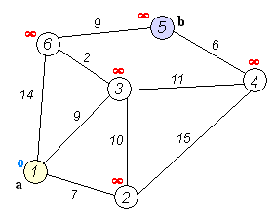
Dijkstra's algorithm
O(n log n) where n is the number of veritces
https://en.wikipedia.org/wiki/Dijkstra%27s_algorithm

Slide 44
Conclude

Slide 45
LAB

